Slide 1
Liver Cancer
Inferential Statistics
Presented by: Barza Kenny

Slide 2
Outline
Difference of survival in days for dead and survived patient
What factors influence the survival in days variable?
What factors influence the death variable?
What is the distribution of the tumour size variable?
What is the distribution of the survival in days variable?
What is the distribution of the MST?

Slide 3
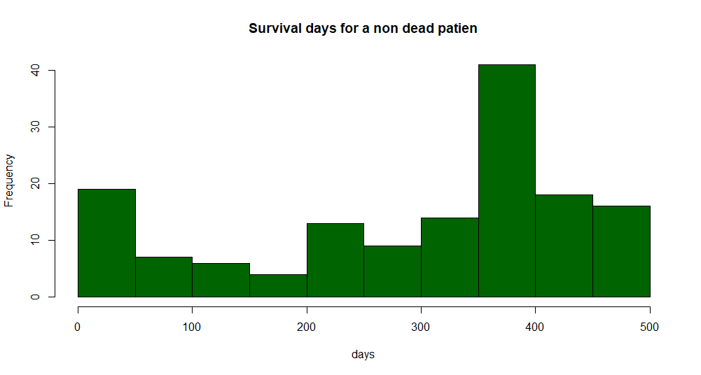
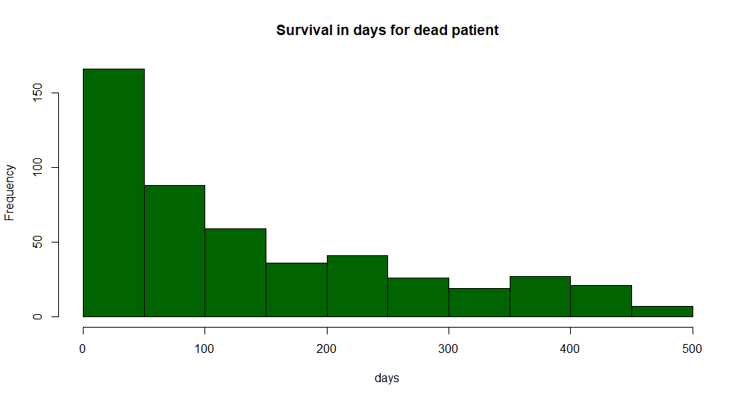
Difference between dead and survived patient

Slide 4
Interval confidence for the mean
Survived Patient
I=[464.73;501.08]
Dead Patient
I=[129.39;152.38]

Slide 5
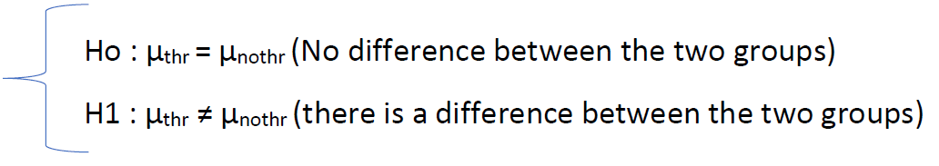
How Hypothesis testing work
(Note here that α=0.05)

Slide 6
Factors that have an impact on the Survival in Days variable
Screening
Diffuse Cancer
Metastatic
Curative
Alcohol
CancerStages
HCV
Thrombosis
Tumour size

Slide 7
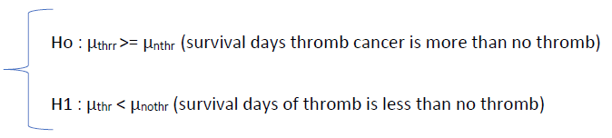
How Hypothesis testing work
(Note here that α=0.05)

Slide 8
Factors that negatively influence the survival days
Diffuse Cancer
Metastatic
Cancer stages
HCV
Thrombosis
Alcohol

Slide 9
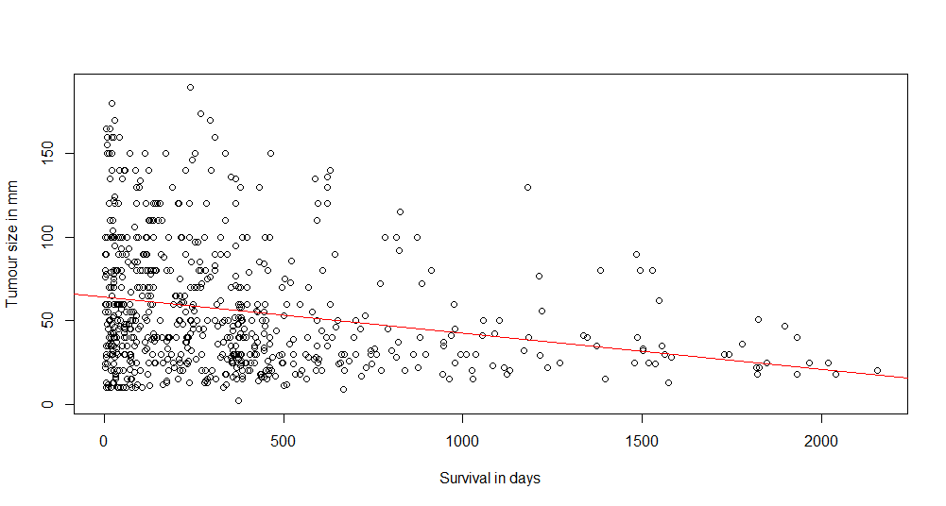
Tumour size also have a negative influence
Y=-0.021X+64.4275

Slide 10
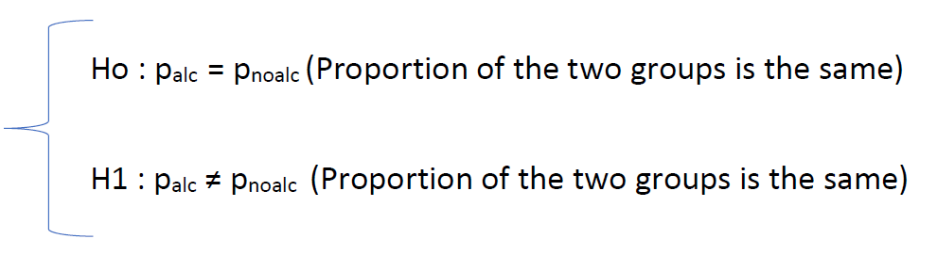
How Hypothesis testing work
(Note here that α=0.05)

Slide 11
Factors that influence the death variable
Age groupe
Gender
Thrombosis
Diffuse Cancer
Metastatic
Curative
HCV
Alcohol
Criteria (tumour size smaller or bigger than 5cm)
Cancer stage

Slide 12
What conclusion can we have?

Slide 13
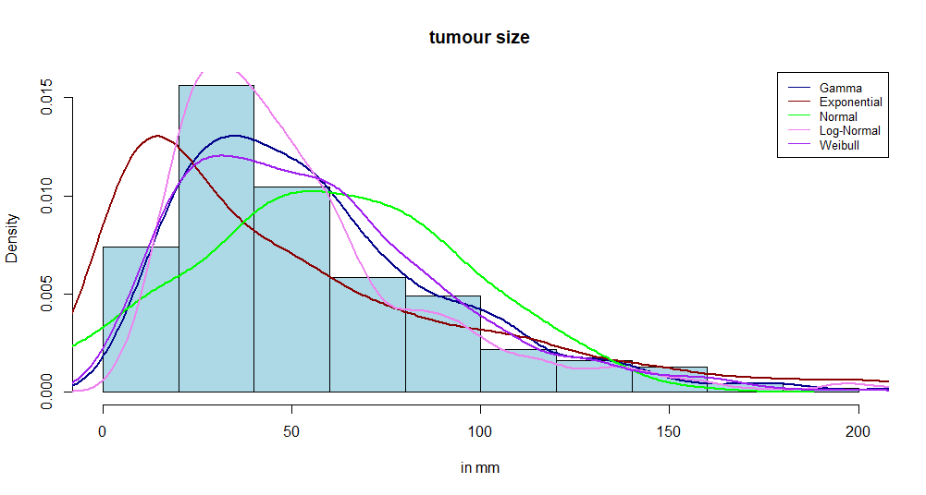
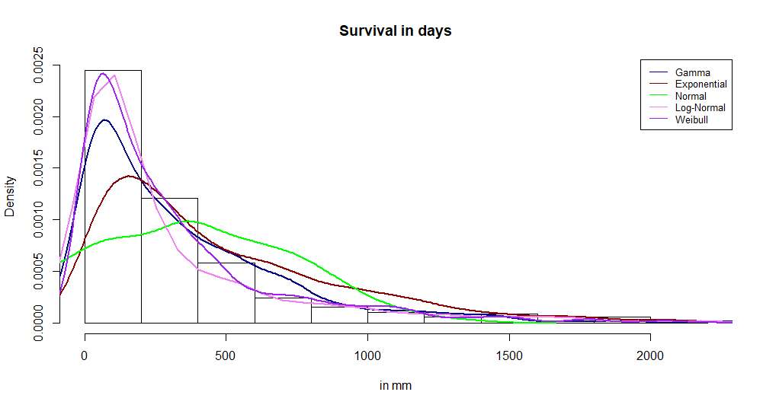
Which distribution does the survival in days and Tumour size follow?

Slide 14
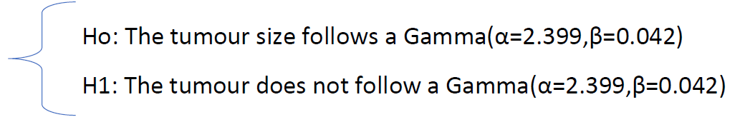
How the tests work?
(Note here that α=0.05)
Example taken from Tumour size.

Slide 15
Results
Tumour size follows a Weibull Distribution of parameter (k=0.833, λ=298.7)
Survival in Days follow a log normal: LN(3.808,0.686)

Slide 16

Mst formula
MST$=3DT\frac{ln⁡(\frac{dt1}{dto})}{ln⁡(2)}$
DT : Doubling time
dt1: Tumour size of unscreened patients
dto: Minimum tumour size detected

Slide 17
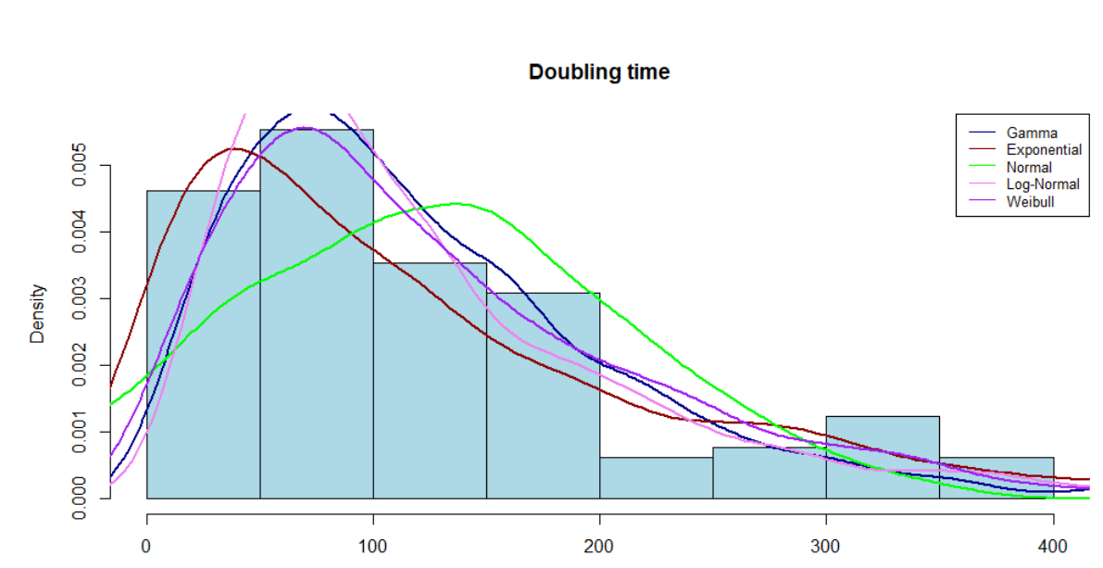
DOUBLING TIME dISTRIBUTION
DT follows a log normal distribution LN(4.565,0.771)

Slide 18
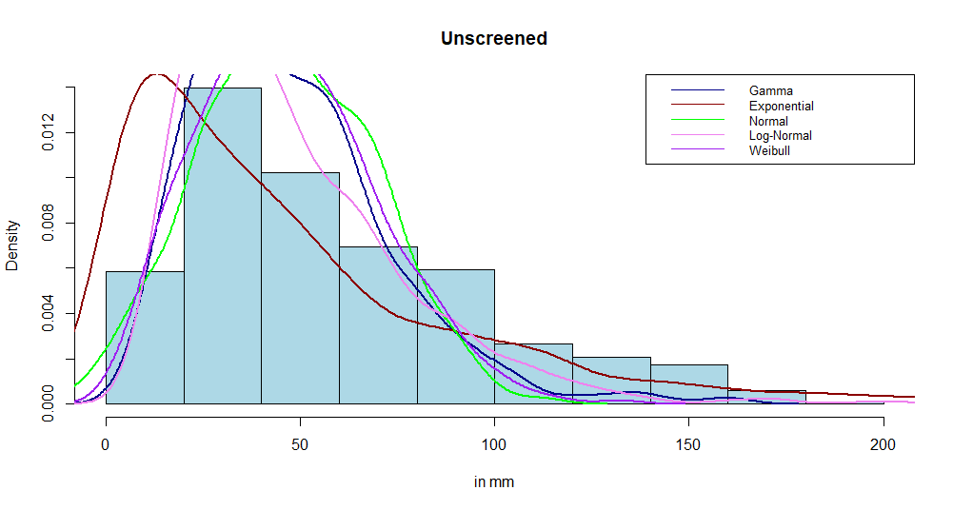
Tumour size of unscreened patient
dt1 follows a Weibull Distribution (k=2.14;λ=52.45)

Slide 19
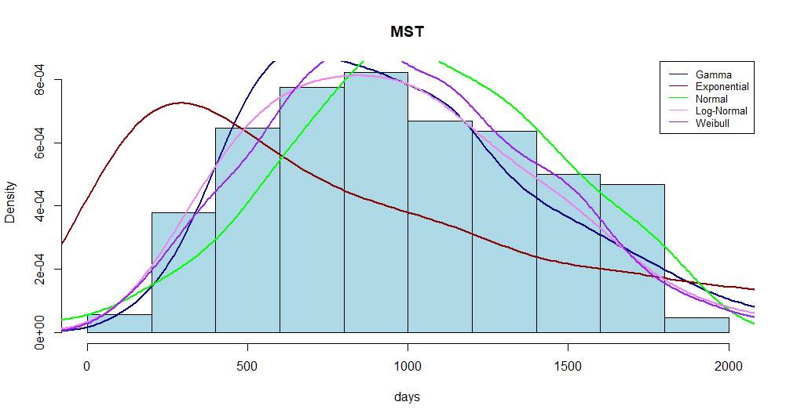
MST distribution
MST follows a Weibull Distribution (k=2.49λ=1.17e+3)

Slide 20
Calculating the MST
The mean is equal to 986 days
The interval confidence is I=[953.49;1006.55]

Slide 21
Conclusion

